Slide 1

Course : COMP6176 / Human - Computer Interaction
Year : 2019
EMOTIONAL INTERACTION
SESSION 05

Slide 2
LEARNING OUTCOMES
LO 1: Describe the concept of interaction design
LO 2: Use guidelines, principles ,models, and framework related with interaction design

Slide 3

OUTLINE
Introduction
Emotions and The User Experience
Expressive interfaces and Emotional Design
Annoying Interfaces
Affective Computing and Emotional AI
Persuasive Technologies and Behavioral Change
Anthropomorphism

Slide 4
INTRODUCTION
When you receive some bad news, how does it affect you? Do you feel upset, sad, angry, or annoyed—or all of these? Does it put you in a bad mood for the rest of the day? How might technology help?
Imagine a wearable technology that could detect how you were feeling and provide a certain kind of information and suggestions geared toward helping to improve your mood, especially if it detected that you were having a real downer of a day.

Slide 5
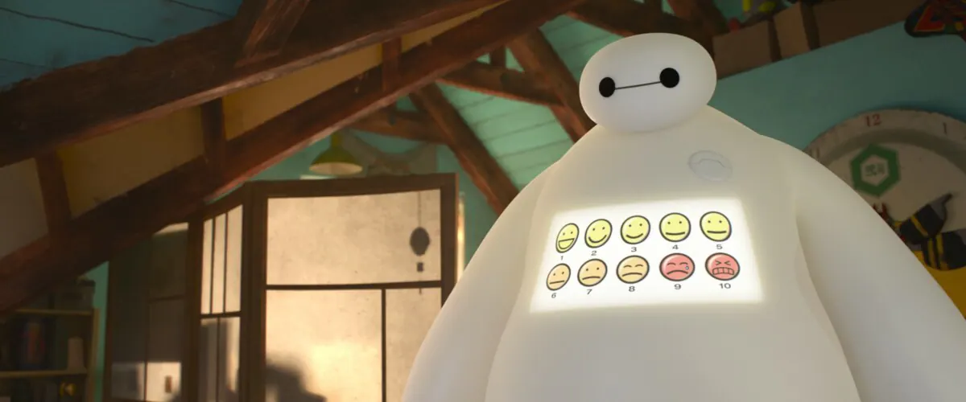
Do you remember this?

Slide 6
INTRODUCTION
Designing technology to detect and recognize someone’s emotions automatically from sensing aspects of their facial expressions, body movements, gestures, and so forth is a growing area of research often called emotional AI or affective computing.
There are many potential applications for using automatic emotion sensing, other than those intended to cheer someone up, including health, retail, driving, and education.

Slide 7
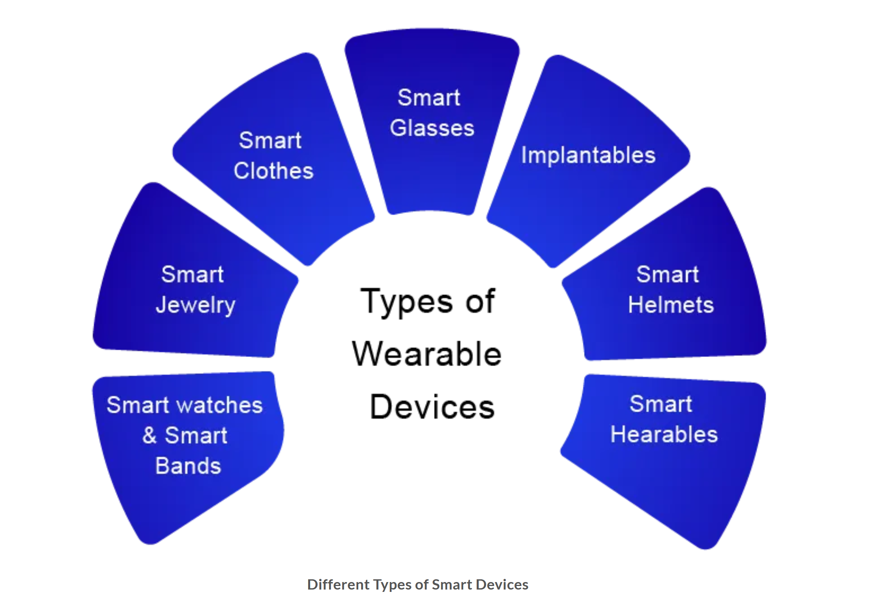
Smart Devices
https://www.delveinsight.com/blog/wearable-technology-trends-2022

Slide 8
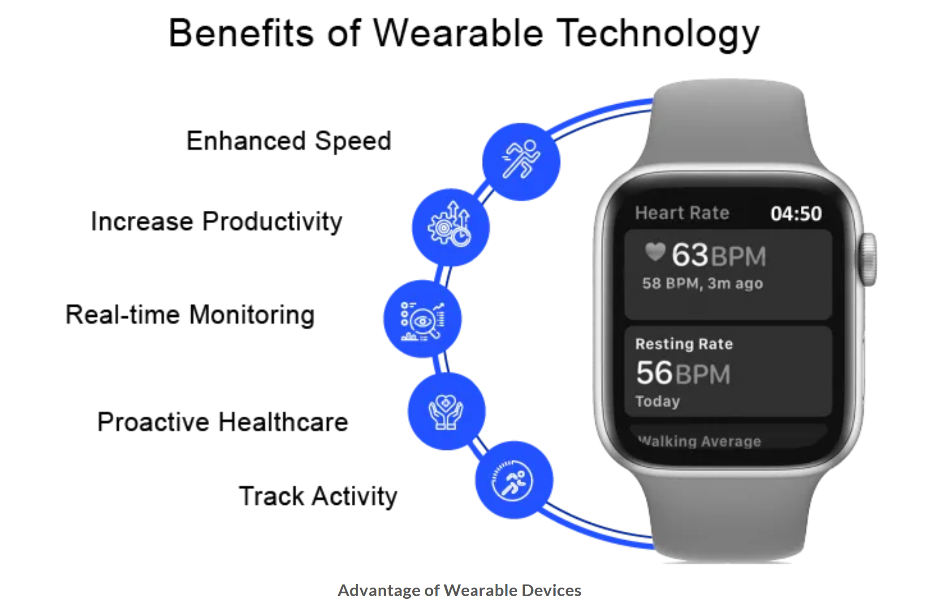
https://www.delveinsight.com/blog/wearable-technology-trends-2022

Slide 9
INTRODUCTION
In addition, emotional design is a growing area relating to the design of technology that can engender desired emotional states, for example, apps that enable people to reflect on their emotions, moods, and feelings.
The focus is on how to design interactive products to evoke certain kinds of emotional responses in people.

Slide 10
EMOTIONS AND
THE USER EXPERIENCE
Emotional interaction is concerned with how we feel and react when interacting with technologies
It covers different aspects of the user experience, from how we feel when first finding out about a new product to getting rid of it.
It also looks at why people become emotionally attached to certain products e.g virtual pets, how social robots might help reduce loneliness and how to change human behavior through the use of emotive feedback.

Slide 11
EMOTIONS AND
THE USER EXPERIENCE
A good place to start understanding how emotions affect behavior and how behavior affect emotions is to examine how people express themselves and read each other’s expressions.
These include understanding the relationship between facial expressions, body language, gestures, and tone of voice.
For example when people are happy they typically smile, laugh, and open their bodies up. When they are angry they shout, gesticulate, and screw up their face.

Slide 12
EMOTIONS AND
THE USER EXPERIENCE
Emotional skills, especially the ability to express and recognize emotions, are central to human communication.
In additions to creating user experiences that elicit, avoid, or encourage certain kinds of emotional reactions, another approach called affective computing, has attempted to develop computer-based systems that recognize and express emotions in the same way humans do (Picard,1998).
However, it should be stressed that designing computers to artificially care for humans, through listening, empathizing and being cheerful, is not viewed as a replacement for human care but as an aid.

Slide 13
EXPRESSIVE INTERFACES
AND EMOTIONAL DESIGN
Expressive forms like emoticons, sounds, icons, and virtual agents have been used at the interface to :
Convey emotional states
Elicit certain kinds of emotional responses in users, such as feeling at ease, comfort, and happiness.
A classic from the 1980s and 1990s was the happy Mac icon that appeared on the screen of the Apple computer whenever the machine was booted (Figure 05.01a) or sad icon face (figure 05.01b) or Mac icon shows its face on a iPod (figure 05.01c).

Slide 14
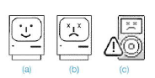
EXPRESSIVE INTERFACES
AND EMOTIONAL DESIGN
Figure 05.01 Smiling and sad Apple icons for the classic Mac (a) and (b) and for the ipod (c)
One of the benefit of using these kinds of expressive embellishments is provide reassuring feedback to the user that can be both informative and fun.

Slide 15
EXPRESSIVE INTERFACES
AND EMOTIONAL DESIGN
Other ways of conveying expressivity include the following:
Animated icons (for example, a recycle bin expanding when a file is placed in it and paper disappearing in a puff of smoke when emptied)
Sonifications indicating actions and events (such as whoosh for a window closing, “schlook” for a file being dragged, or ding for a new email arriving)
Vibrotactile feedback, such as distinct smartphone buzzes that represent specific messages from friends or family

Slide 16
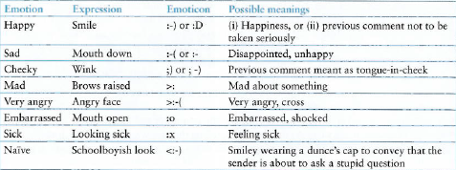
EXPRESSIVE INTERFACES
AND EMOTIONAL DESIGN
A universal method is the use of emoticons, originally keyboard symbols that were combine in various ways to convey feelings and emotions by simulating facial expressions such as smiling, winking, and frowning on the screen.(See Figure 05.02)
Figure 05.02 Some commonly used emoticons

Slide 17
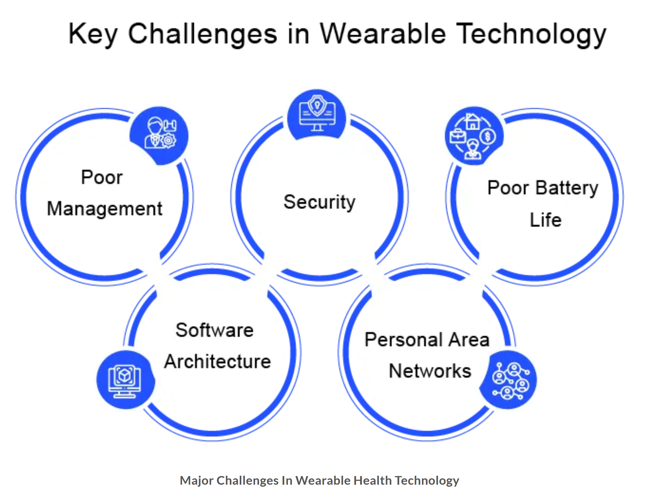

Slide 18
ANNOYING INTERFACES
In many situations, computer interfaces may inadvertently elicit negative emotional responses, such as anger and disgust.
This typically happens when something that should be simple to use or set turns out to be complex.
For example : Getting a printer to work with a new digital camera, trying to switch from watching a DVD to a TV channel, and changing the time on a digital alarm clock in a hotel can be very trying.

Slide 19


https://www.menti.com/alnu6pekv63q

Slide 20
ANNOYING INTERFACES
Interfaces, if designed poorly can make people look stupid or feel insulted or threatened. There are many reasons why such emotional responses occurs :
When an application doesn’t work properly or crashes
When a system doesn’t do what the user wants it to do
When a user’s expectations are not met.
When a system does not provide sufficient information to let the user know what to do.
When error message pop up that are vague or obtuse.
When the appearance of an interface is too noisy ,garish, gimmicky or patronizing.
When a system requires users to carry out too many steps to perform a task, only to discover a mistake was made somewhere along the line and they need to start all over again.

Slide 21
ANNOYING INTERFACES
8. Websites that are overloaded with text and graphics, making it difficult to locate desired information and resulting in sluggish performance.
9. Flashing animations, especially flashing banner ads and pop-up ads that cover the user view and which require them to click in order to close them.
10. The overuse or automatic playing of sound effects and music, especially when selecting options, carrying out actions, running tutorials, or watching website demos.
11. Featuritis-an excessive number of operations, such as an array of buttons on remote controls.
12. Poorly laid-out keyboards, touchpads, control panels, and other input devices that cause users to press the wrong keys or buttons persistently.

Slide 22
ANNOYING INTERFACES
Some reason that can make user frustrations because of bad interfaces :
Gimmicks
ex : frustration can happen when clicking on a link to a website only to discover that it is still under construction
Error Message
Threatening error message can also cause users to become anxious.
Waiting
Ex : websites or software apps that for ever to download

Slide 23
ANNOYING INTERFACES
Upgrading
More often than not it is time-consuming, requiring a range of things such as resetting preferences, checking other configurations and learning new ways of doing things.
Appearance
People are often annoyed by appearance of text and graphics on websites, flashing animations, the over-use of sound effect and music, featuritis, childish design, poorly laid out keyboards, pads, or control panels

Slide 24
ANNOYING INTERFACES
(Your Turn)
DILEMMA
Should Voice Assistants Teach Kids Good Manners?

Slide 25
Affective Computing
and Emotional AI
Affective computing is concerned with how to use computers to recognize and express emotions in the same way as humans do.
More recently, emotional AI has emerged as a research area that seeks to automate the measurement of feelings and behaviors by using AI technologies that can analyze facial expressions and voice in order to infer emotions.

Slide 26
Affective Computing
and Emotional AI
The main techniques and technologies that have been used to do this are as follows:
Cameras for measuring facial expressions
Biosensors placed on fingers or palms to measure galvanic skin response (which is used to infer how anxious or nervous someone is as indicated by an increase in their sweat)
Affective expression in speech (voice quality, intonation, pitch, loudness, and rhythm)
Body movement and gestures, as detected by motion capture systems or accelerometer sensors placed on various parts of the body

Slide 27
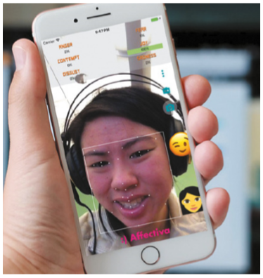
Affective Computing
and Emotional AI
Figure 05.03 Facial coding using Affdex software

Slide 28
Persuasive Technologies
and Behavioral Change
A diversity of technologies is increasingly being used to draw people’s attention to certain kinds of information in an attempt to change what they do or think.
Pops-up ads, warning messages, reminders, prompts, personalized messages, and recommendations are some of the methods that are being deployed on computer screens.
Phenomenon persuasive technology : interactive computing systems are deliberately designed to change people’s attitudes and behaviors. (Fogg,2003).

Slide 29
Persuasive Technologies
and Behavioral Change
Example :
Amazon’s one click mechanism makes it so easy and tempting to buy something at their online store,
Nitendo’s Pokemon Pikachu 2 GS with pedometer attached that was designed to motivate children into being more physically active on a consistent basis.
The WaterBot system was developed using a special monitoring and feedback device but for adults as a way of reducing their usage or water in their homes.

Slide 30
ANTHROPOMORPHISM
Anthropomorphism is :
The propensity people have to attribute human qualities to animals and objects
For example : the development of computer-based cuddly toys such as Barney was programmed to congratulate the child whenever she produced a right answer.
People especially children have a propensity to accept and enjoy objects that have been given human-like qualities has led many designers to capitalize on it.
Most notably in the design of virtual agents and interactive dolls, robots, and cuddly toys.

Slide 31

QUIZ
https://forms.office.com/r/UNdjNHwtu2

Slide 32
REFERENCES
Interaction Design 5th Edition 2019, Chapter 6
https://www.interaction-design.org/literature/topics/emotional-design
https://www.academia.edu/32342797/Emotions_in_the_Social_Aspects_of_Human-Computer_Interaction
http://www.ruthcsmith.com/wp-content/uploads/2012/10/AnthropomorphicAgents.pdf
https://www.inverse.com/article/6807-annoying-interfaces-that-work-well

